Slide 1

Chapter 8 Security
Computer Networking: A Top-Down Approach 8th edition Jim Kurose, Keith Ross Pearson, 2020
Acknowledgement: Based on the textbook’s website: https://gaia.cs.umass.edu/kurose_ross/index.php
Notes:
Version History
8.0 (May 2020)
All slides reformatted for 16:9 aspect ratio
All slides updated to 8th edition material
Use of Calibri font, rather that Gill Sans MT
Add LOTS more animation throughout
lighter header font
wireless security completely redone (updated WiFi and added 4G/5G)
SSL material replaces by TLS 1.3 (up-to-date)
V8.2 (Feb 2022)
Minor corrections

Slide 2
Overview
Secret Key Encryption
Public Key Encryption
Hash Functions, Digital Signature, Digital Certificates
Secure e-mail
Transport Level Security (TLS)
IP Security (IPsec)
Firewalls and Intrusion detection systems (IDS)

Slide 3
Public Key Encryption Method
Rivest, Shamir, and Adelson (RSA) method
Example: Key1 = <3,187>, Key2 = <107,187>
Encrypted_Message = m³ mod 187
Message = Encrypted_Message¹⁰⁷ mod 187
Message = 5
Encrypted Message = 5³ = 125 mod 187 = 125
Message = 125¹⁰⁷ mod 187 = 5. But direct computation will cause arithmetic overflow
₌ ₁₂₅(64+32+8+2+1) _{mod 187}
= {(125⁶⁴ mod 187)(125³² mod 187)...
(125² mod 187)(125 mod 187)} mod 187

Slide 4
Modular Arithmetic
xy mod m = (x mod m) (y mod m) mod m
x⁴ mod m = (x² mod m)(x² mod m) mod m
x^{ij} mod m = (x^{i} mod m)^{j} mod m
125 mod 187 = 125
125² mod 187 = 15625 mod 187 = 104
125 mod 187 = (125 mod 187) mod 187
= 104² mod 187 = 10816 mod 187 = 157
Notation:
x = y mod z or
x = y (mod z) or
x mod z = y
4 2 2
125 mod 187 = 157 mod 187 = 152
125 mod 187 = 152 mod 187 = 103
125³² mod 187 = 103² mod 187 = 137
125⁶⁴ mod 187 = 137² mod 187 = 69
₁₂₅107₌ ₁₂₅64+32+8+2+1 _{mod 187}
= 69×137×152×104×125 mod 187
= 18679128000 mod 187 = 5
You need to be able to do additions to convert 107 to 64+32+8+2+1
8 2
16 2

Slide 5
RSA Public Key Encryption
Ron Rivest, Adi Shamir, and Len Adleman at MIT 1978
Both plain text M and ciphertext C are integers between 0 and n-1.
Key 1 = {e, n}, Key 2 = {d, n}
C = Me mod n
M = C^{d} mod n
How to construct keys:
Select two large primes: p, q, p ≠ q
n = p×q
Calculate z = (p-1)(q-1)
Select e, such that gcd(z, e) = 1; 0 < e < z
Calculate d such that de mod z = 1

Slide 6
RSA Algorithm: Example
Select two large primes: p, q, p ≠ q p = 17, q = 11
n = p×q = 17×11 = 187
Calculate z = (p-1)(q-1) = 16x10 = 160
Select e, such that gcd(z, e) = 1; 0 < e < z say, e = 7
Calculate d such that de mod z = 1
160k+1 = 161, 321, 481, 641
Check which of these is divisible by 7
161 is divisible by 7 giving d = 161/7 = 23
Key 1 = {7, 187}, Key 2 = {23, 187}

Slide 7




Signed Secure E-Mail
Alice wants to provide secrecy, sender authentication, message integrity.
Message
Hash
Message
Message Digest
Alice’s Private Key
Secret Key
Secret Key
Bob’s Public Key
Message Digest
Encrypt
Alice’s Private Key
Alice uses three keys: her private key, Bob’s public key, newly created secret key
Bob uses his private key to recover the secret key
Bob uses Alice’s public key to verify that the message came from Alice and was not changed.

Slide 8
Pretty Good Privacy (PGP)
Used RSA and IDEA (RSA patent in the US until 2000)
V2.6.2 became legal for use within the US and can be downloaded from MIT
A patent-free version using a public algorithm has also been developed
Code published as an OCRable book
Initially used the web of trust- certificates issued by people
Certificates can be registered on public sites, e.g., MIT
hushmail.com is an example of a PGP mail service
OpenPGP standard [RFC 4880]
MIME=Multipurpose Internet Mail Extension. Allows non-ASCII characters to be encoded in ASCII
Ref: http://en.wikipedia.org/wiki/Pretty_Good_Privacy , https://en.wikipedia.org/wiki/MIME

Slide 9
Transport Layer Security (TLS)
Web Traffic Security Approaches
History
SSL/TLS Architecture
SSL/TLS Protocol Components
Secure HTTP (HTTPS)

Slide 10
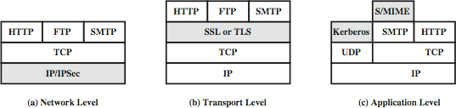
Web Traffic Security Approaches
(Not covered in this course)
SSL/TLS provides the following services over the TCP layer:
Crypto Negotiation: Negotiate encryption and hash methods
Key Exchange: Secret key exchange using public key certificates
Privacy: Encryption using a secret key
Integrity: Message authentication using a keyed hash

Slide 11
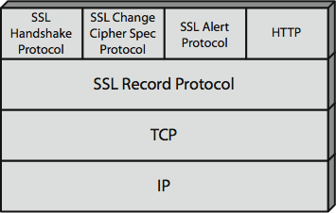
SSL/TLS Architecture
SSL has four components in two layers
Handshake protocol: Negotiates crypto parameters for an “SSL session” that can be used for many “SSL/TCP connections.”
Record Protocol: Provides encryption and MAC
Alert protocol: To convey problems
Change Cipher Spec Protocol: Implement negotiated crypto parameters

Slide 12
SSL/TLS Handshake Protocol
Allows server and client to:
Authenticate each other
To negotiate encryption & MAC algorithms
To negotiate cryptographic keys to be used
Comprises a series of messages in phases
Establish Security Capabilities
Server Authentication
Client Authentication and Key Exchange
Finish

Slide 13
SSL/TLS Handshake Protocol Actions
Client Server
Client Hello: Crypto Choices (Protocol Version, Cipher Suite, Compression, R_{Client}
Server Hello: Crypto Selected, R_{Server}
Certificate: Server Certificate (Optional)
Server Key Exchange (Optional)
Certificate Request (Optional)
Server Hello Done
Generate random PMS S
Compute MS K
Certificate: Client Certificate
Client Key Exchange: E(K_{server Public Key}, PreMasterSecret)
Certificate Verify
Compute MS K
Change Cipher Spec
Handshake Finished: Hash and MAC of Previous messages
Change Cipher Spec
Handshake Finished

Slide 14
Cryptographic Computations
Master secret creation
A one-time 48-byte value based on nonces
A 48-byte pre-master secret is exchanged/generated using secure key exchange (RSA / Diffie-Hellman) and then hashing:
Master_Secret = MD5(Pre_master_Secret || SHA(‘A’ || pre_master_secret || clientHello.random || ServerHello.random)) ||
MD5(Pre_master_Secret || SHA(‘BBB’ || pre_master_secret || clientHello.random || ServerHello.random)) || MD5(Pre_master_Secret || SHA(‘CCC’ || pre_master_secret || clientHello.random || ServerHello.random))
Generation of cryptographic parameters
A “client write MAC secret,” “a server write MAC secret,” “a client write key,” “a server write key,” “a client write IV,” and “a server write IV.”
Generated by hashing the master secret

Slide 15

SSL/TLS Change Cipher Spec Protocol
A single 1-byte message
Causes negotiated parameters to become current
Hence updating the cipher suite in use

Slide 16

SSL/TLS Alert Protocol
Conveys SSL-related alerts to the peer entity
Two-byte message: Level-Alert, level = warning or fatal, fatal ⇒ Immediate termination
0
10
20
21
22
41
42
43
44
Close notify (warning or fatal) Unexpected message (fatal) Bad record MAC (fatal)
Decryption failed (fatal, TLS only) Record overflow (fatal, TLS only)
No certificate (SSL v3 only) (warning or fatal) Bad certificate (warning or fatal)
Unsupported certificate (warning or fatal) Certificate revoked (warning or fatal)
45 Certificate expired (warning or fatal)
….

Slide 17
SSL/TLS Record Protocol Services
Confidentiality
Using symmetric encryption with a shared secret key defined by Handshake Protocol
AES, IDEA, RC2-40, DES-40, DES, 3DES, Fortezza, RC4- 40, RC4-128
The message is compressed before encryption
Message integrity
Using the MAC with the shared secret key
Similar to HMAC but with different padding

Slide 18
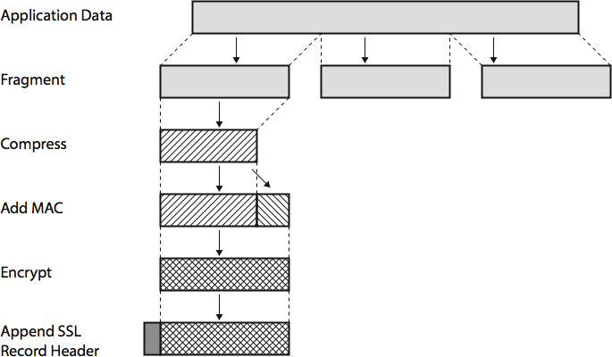
SSL/TLS Record Protocol Operation

Slide 19
Secure HTTP (HTTPS)
HTTPS (HTTP over SSL)
Combination of HTTP & SSL/TLS to secure communications between browser & server [RFC2818]
Use HTTPS:// URL rather than HTTP://. Use port 443 rather than 80
Encrypts URL, document contents, form data, cookies, HTTP headers
HTTP 1.1
HTTP/2
HTTP/3
Application
TLS/SSL
TLS 1.2+
TLS 1.3
QUIC
Transport
UDP
IPv4/IPv6

Slide 20
Secure HTTP (HTTPS)
HTTPS (HTTP over SSL)
Combination of HTTP & SSL/TLS to secure communications between browser & server [RFC2818]
Use HTTPS:// URL rather than HTTP://. Use port 443 rather than 80
Encrypts URL, document contents, form data, cookies, HTTP headers
HTTP 1.1
HTTP/2
HTTP/3
Application
TLS/SSL
TLS 1.2+
TLS 1.3
QUIC
Transport
UDP
IPv4/IPv6
Ref https://en.wikipedia.org/wiki/HTTP/3

Slide 21
TLS: Summary
1. Netscape invented SSL to secure web transactions
TLS is a revised version of SSL V3
TLS provides
Crypto negotiation,
Secure key exchange,
Privacy via encryption, and
Integrity using a keyed hash.
4. HTTP over TLS is also called HTTPS

Slide 22
IP Security (IPsec) and VPNs
IPsec Applications: VPNs
Two ways to secure:
a. Authentication Header (AH)
b. Encapsulating Security Payload (ESP)
3. Internet Key Exchange (IKE)

Slide 23
IP Security
IPsec provides
Access control: User authentication
Data integrity
Data origin authentication
Rejection of replayed packets
Confidentiality (encryption)
Limited traffic flow confidentiality
Benefits:
Security at Layer 3 ⇒ Applies to all transports/applications
It can be implemented in Firewall/router
⇒ Security to all traffic crossing the perimeter
Transparent to applications and can be transparent to end-users
Can provide security for individual users
Applications: VPNs, Branch Offices, Remote Users, Extranets
Ref: http://en.wikipedia.org/wiki/IPsec

Slide 24
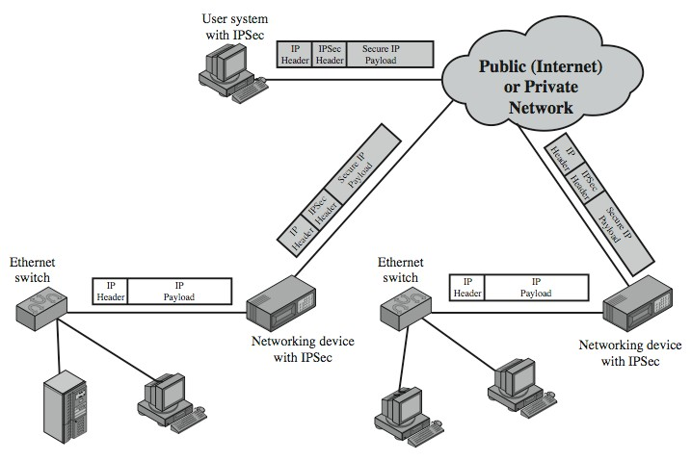
IP Security Applications

Slide 25
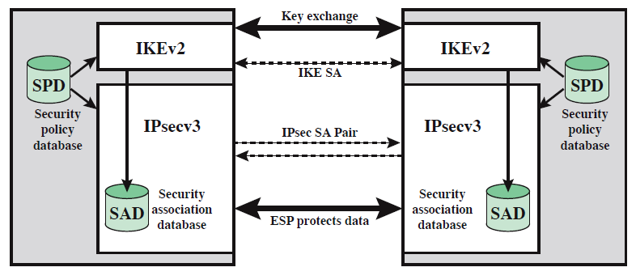
IP Security Architecture
Internet Key Exchange (IKE)
IPsec
Security Association Database (SAD)
Security Policy Database (SPD)

Slide 26
Security Association Database (SAD)
Each host has a database of Security Associations (SAs)
SA = One-way security relationship between sender & receiver Two-way may use different security ⇒Two SA’s required
Defined by three parameters:
Security Parameters Index (SPI)
IP Destination Address
Security Protocol Identifier: AH or ESP
For each SA, the database contains:
SPI
Sequence number counter and counter overflow flag
Anti-replay window (Acceptable sequence #s)
AH Information and ESP information
The lifetime of the SA
Mode: Transport or tunnel or wildcard
Path MTU

Slide 27
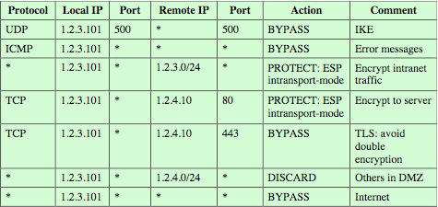
Security Policy Database (SPD)
Relates IP traffic to specific SAs
Match subset of IP traffic to relevant SA
Use selectors to filter outgoing traffic to map
Based on: local & remote IP addresses, next layer protocol, name, local & remote ports

Slide 28


IPsec
Secure IP: A series of proposals from IETF
Separate authentication and privacy
Authentication Header (AH) ensures data integrity and data origin authentication.
Encapsulating Security Protocol (ESP) ensures confidentiality, data origin authentication, connectionless integrity, and an anti-replay service.
IP Header | [AH] | [ESP] | Original IP Header* | Original Data
Encrypted
Authenticated
* Optional

Slide 29


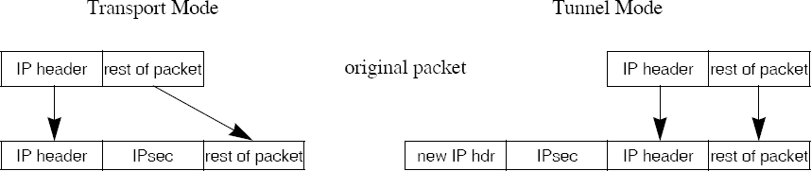
Tunnel vs. Transport Mode
Gateway-to-gateway vs. end-to-end
Router
Router
Gateway-to-Gateway
End-to-end

Slide 30
Authentication Header (AH)
Provides connectionless integrity using a hash function and a shared secret key.
Integrity Check Value (ICV) covers most of the fields in the datagram.
Guarantees data origin (using MAC).
Optionally adds sequence numbers to protect against replay attacks.

Slide 31
Encapsulating Security Payload (ESP)
Provides:
Message content confidentiality,
Data origin authentication,
Connectionless integrity,
Anti-replay service,
Limited traffic flow confidentiality (TFC)
Services depend on options selected when establishing Security Association (SA), net location
Can use a variety of encryption & authentication algorithms

Slide 32
IPsec Key Management (IKE)
Handles key generation & distribution
Typically need two pairs of keys
Two per direction for integrity and confidentiality.
Manual key management
A system administrator manually configures every system.
Automated key management
Automated system for on-demand creation of keys for SAs in large systems.

Slide 33
Summary: IPsec
1. IPsec provides authentication, confidentiality, and
key management at Layer 3. Applies to all traffic passing through IP.
Security associations are one-way and can be bundled together.
Authentication header for message authentication
Encapsulating security protocol (ESP) for confidentiality and integrity
Both can be used end-to-end with the original IP header inside (Tunnel) or without the original IP header (Transport) mode

Slide 34


End Point Authentication
Passwords can not be exchanged in clear Nonce = random number used only once
Also done using certificates
User
Server
Hi I am Alice
Please encrypt this number ‘n’ with your password
Here is the encryption ‘n’ of with my password
Requires the server to store passwords in clear.

Slide 35
Symmetric Encryption Simple Algorithm: Substitution-based
Substitution: Substituting one thing for another
Monoalphabetic: substitute one letter for another
plaintext: abcdefghijklmnopqrstuvwxyz
ciphertext: mnbvcxzasdfghjklpoiuytrewq
E.g.:
Plaintext: bob. i love you. alice ciphertext: nkn. s gktc wky. mgsbc
Polyalphabetic: Use multiple substitutions C1, C2, … The substitution selected depends upon the position.
⇒ The same letter coded differently in different positions.

Slide 36


Secure E-Mail
Alice wants to send a confidential e-mail, m, to Bob.
Message
Encrypt Decrypt
Message
1
5
0
Secret Key
Message
Secret Key
3
Secret Key
4
Encrypt
2
Decrypt
Bob’s Public Key
Bob’s Private Key
Alice:
0. Generates random secret key, K_{S}.
Bob:
Bob uses his private key to recover K_{s}
Bob decrypts the message
1. Encrypts message with K (for efficiency)
S
Also encrypts K_{S} with Bob’s public key.
Sends both K_{S}(m) and K_{B}(K_{S}) to Bob.
Q: Why not encrypt the whole email with Bob’s public key?
A: Since public key crypto is inefficient, this will be too slow.
Recall Slide 39 “Public-Key Crypto in Practice”

Slide 37
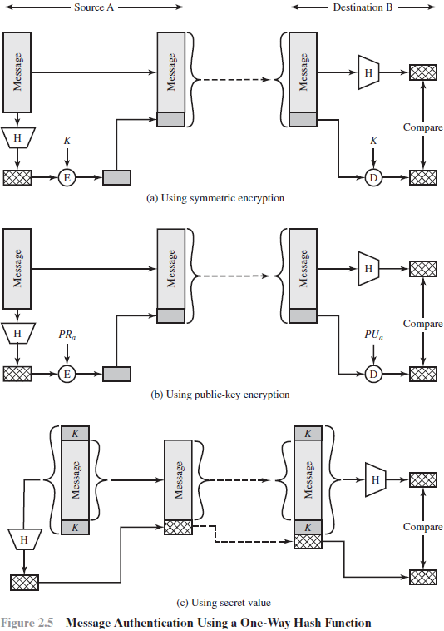
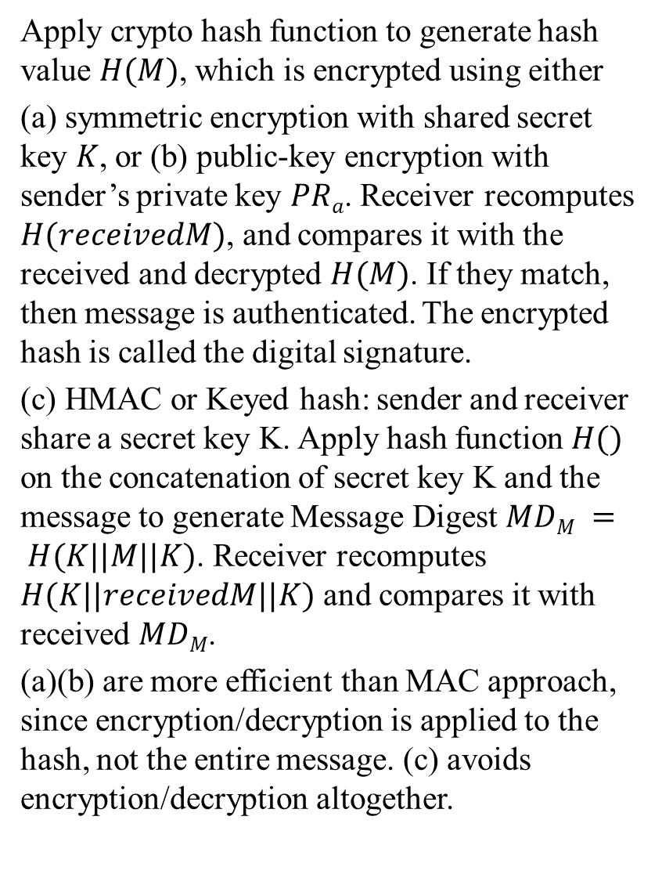
Apply crypto hash function to generate hash value $H(M)$, which is encrypted using either
(a) symmetric encryption with shared secret key $K$, or (b) public-key encryption with sender’s private key $PRa$. Receiver recomputes $H(receivedM)$, and compares it with the received and decrypted $H(M)$. If they match, then message is authenticated. The encrypted hash is called the digital signature.
(c) HMAC or Keyed hash: sender and receiver share a secret key K. Apply hash function $H()$ on the concatenation of secret key K and the message to generate Message Digest $MDM = H(K||M||K)$. Receiver recomputes $H(K||receivedM||K)$ and compares it with received $MDM$.
(a)(b) are more efficient than MAC approach, since encryption/decryption is applied to the hash, not the entire message. (c) avoids encryption/decryption altogether.
Notes:
It is efficient since no encryption/decryption is used.
Message Digest = Hash(Message)
Signature = Encrypt(Private_Key, Hash)
Hash(Message) = Decrypt(Public_Key, Signature)
⇒ Authentic
Private Key

